Slide 1

Team: Code Brigade
-K.Murali Devi
-K.P.Aishwarya
-J.Kunal.

Slide 2
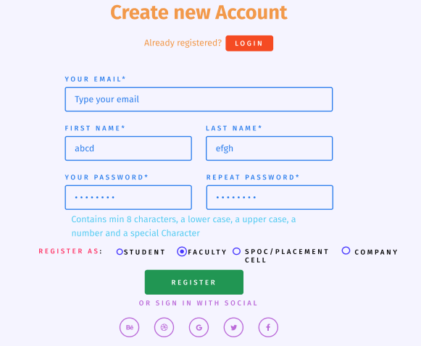
Login ui:
It contains 4 different modules for a person logging in.
The person can give his basic credentials and then choose his role.
After this, he can register himself into the particular segment.

Slide 3
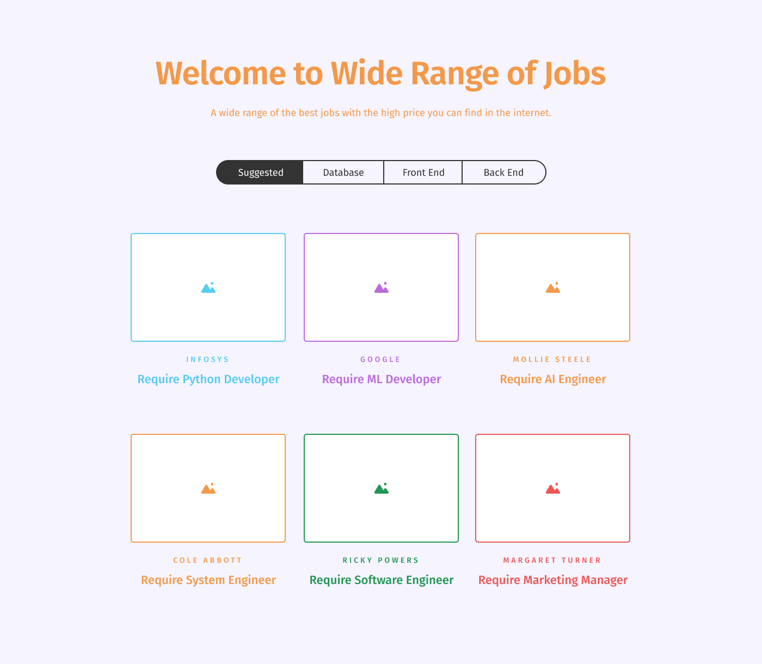
As a student, applicant can apply for what he chooses.
Applicant UI

Slide 4
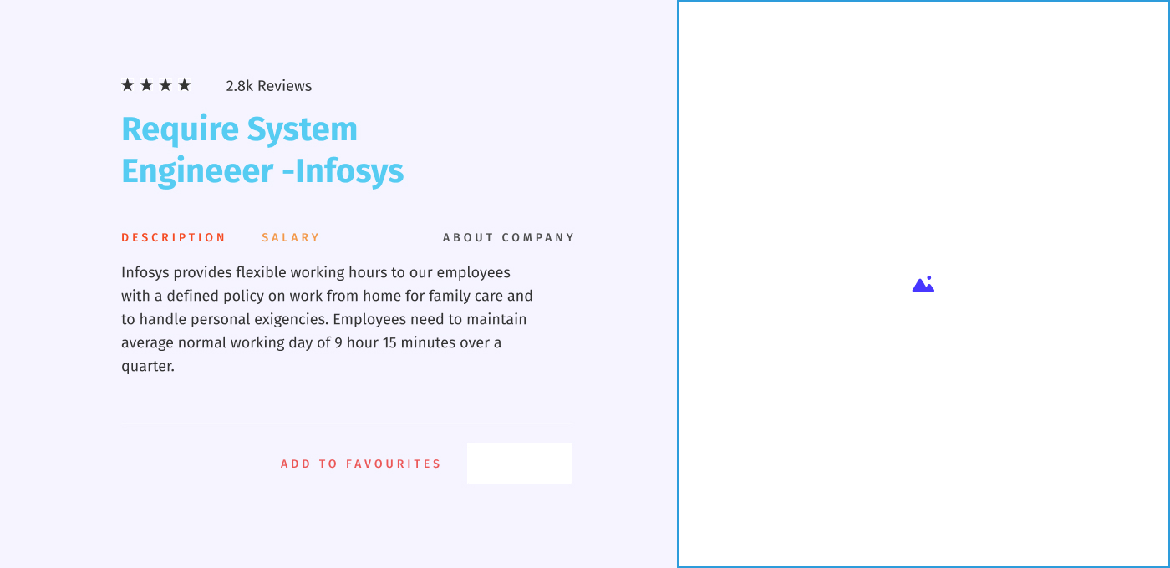
ANd get description of the job:

Slide 5
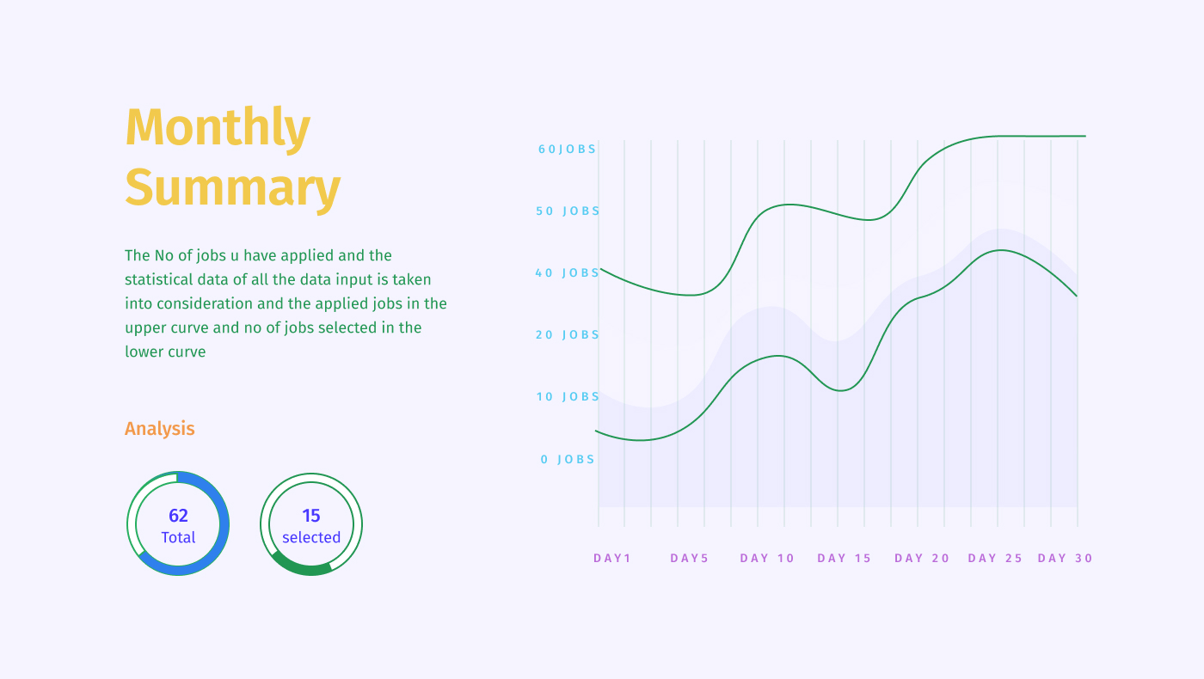
Dash Board of Applicant
And One can view his summary

Slide 6
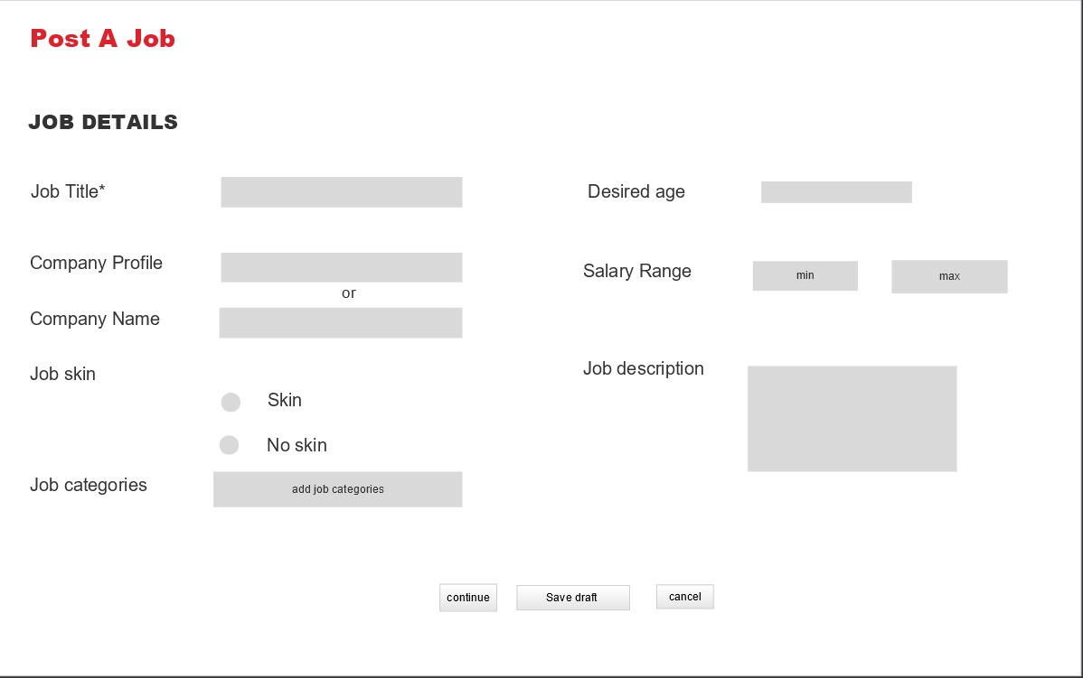
When a company needs to post a job

Slide 7
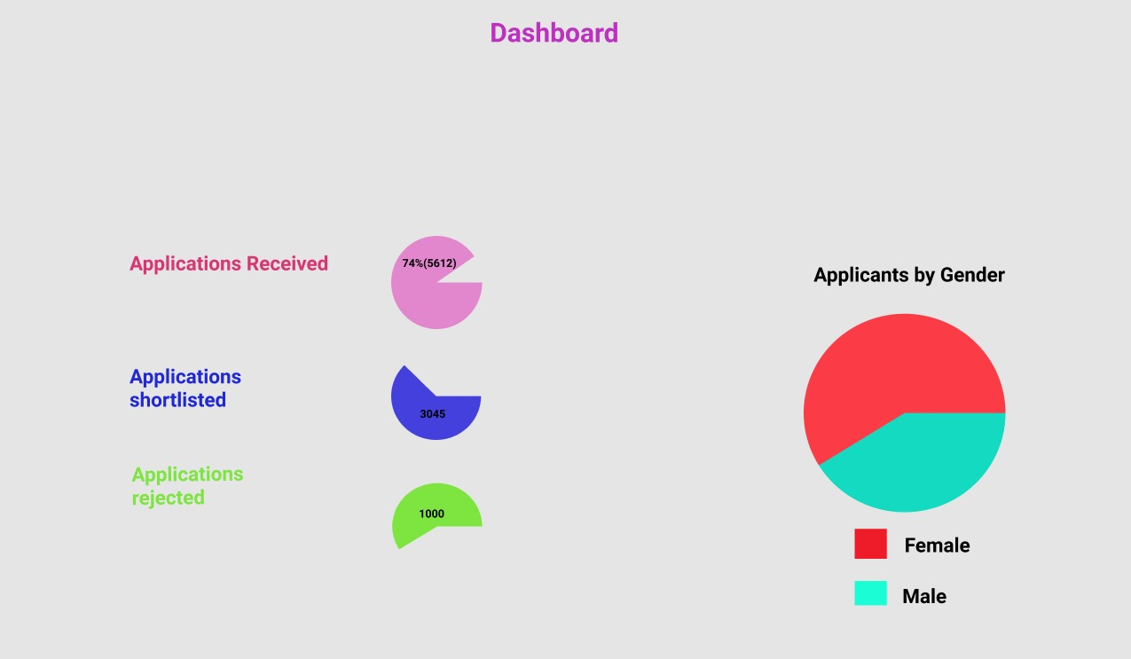
Company Dashboard

Slide 8
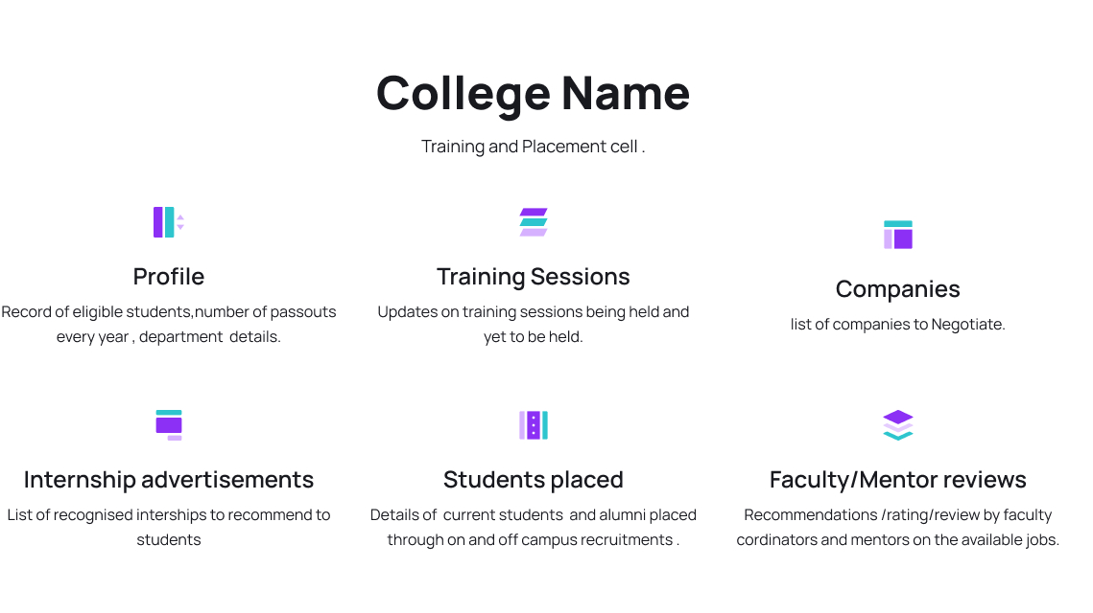
SPOC/Placement officer:

Slide 9
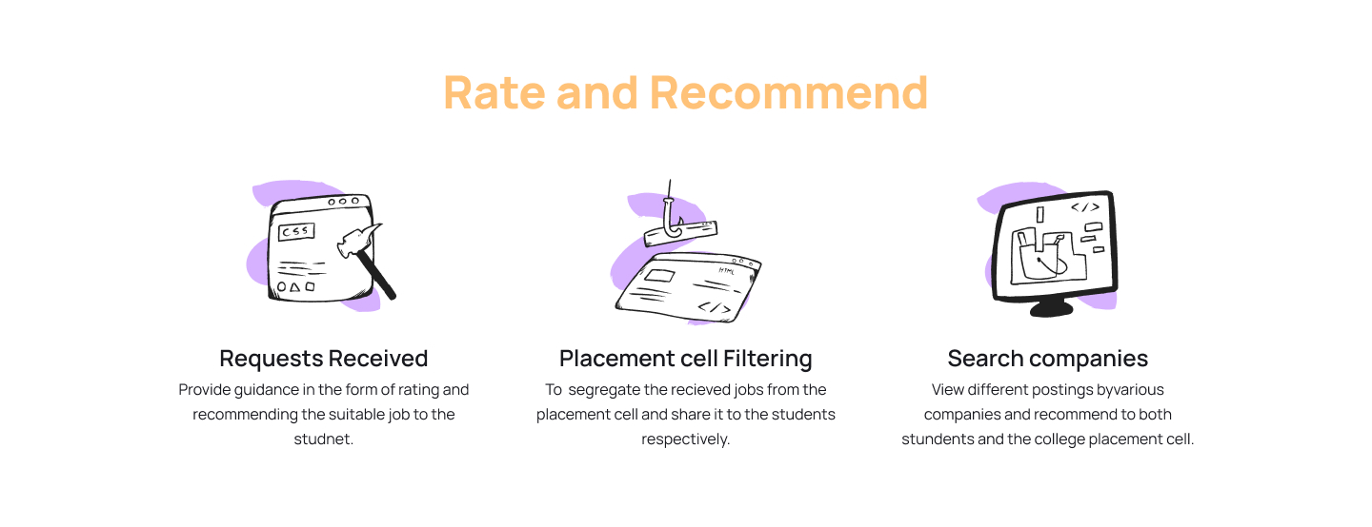
Faculty/Mentor:

Slide 10

Thank You

